Slide 1
Research Progress Track
Danlu Huang

Slide 2
Rough Plan
1st week: Study the report in depth, get familiar with the new Arduino board, study the code, finish reproducing the original project
2-4 week: switch to new robot, modify code, get things working +-+
5-7 week: finalize project, write report

Slide 3
May 21, Day 1
Study the MEng report, take notes
Assemble Arduino kit, try out example modules 1&2
familiarize with Arduino IDE syntax by writing a small module for LEDs

Slide 4
Notes on the MEng report
Dual core ARM Cortex-9 as host processor, controls the main execution flow of the project, since it can access all peripheral ports like HDMI and ethernet
Xilinx Zynq FPGA as video accelerator for gesture recognition
1. software design: camera capture, gesture recognition, command sending on Intel i3 processor + programming Intel Galileo
2. hardware design: heterogeneous core to replace software design on i3 processor

Slide 5
software design
Visual studio for C
OpenCV library APIs for gesture recognition
get corners, *denoise
RGB to YCbCr
thresholding/filtering
windows winsock APIs:
send packet of driving command
over TCP network
wireless network:
virtual access point in laptop, private SSID and password
Galileo receive via N-135, write to iRobot’s serial interface

Slide 6
software design: gesture recognition
color conversion
median filter over space: 5x5 window (?)
median filter over time: previous 8 frames

Slide 7
May 22, Day 2
some more Arduino Uno code try-outs (LED binary counter demo)
start to reproduce the demo of controlling iRobot with keyboard instructions
Install necessary softwares and setup environments

Slide 8
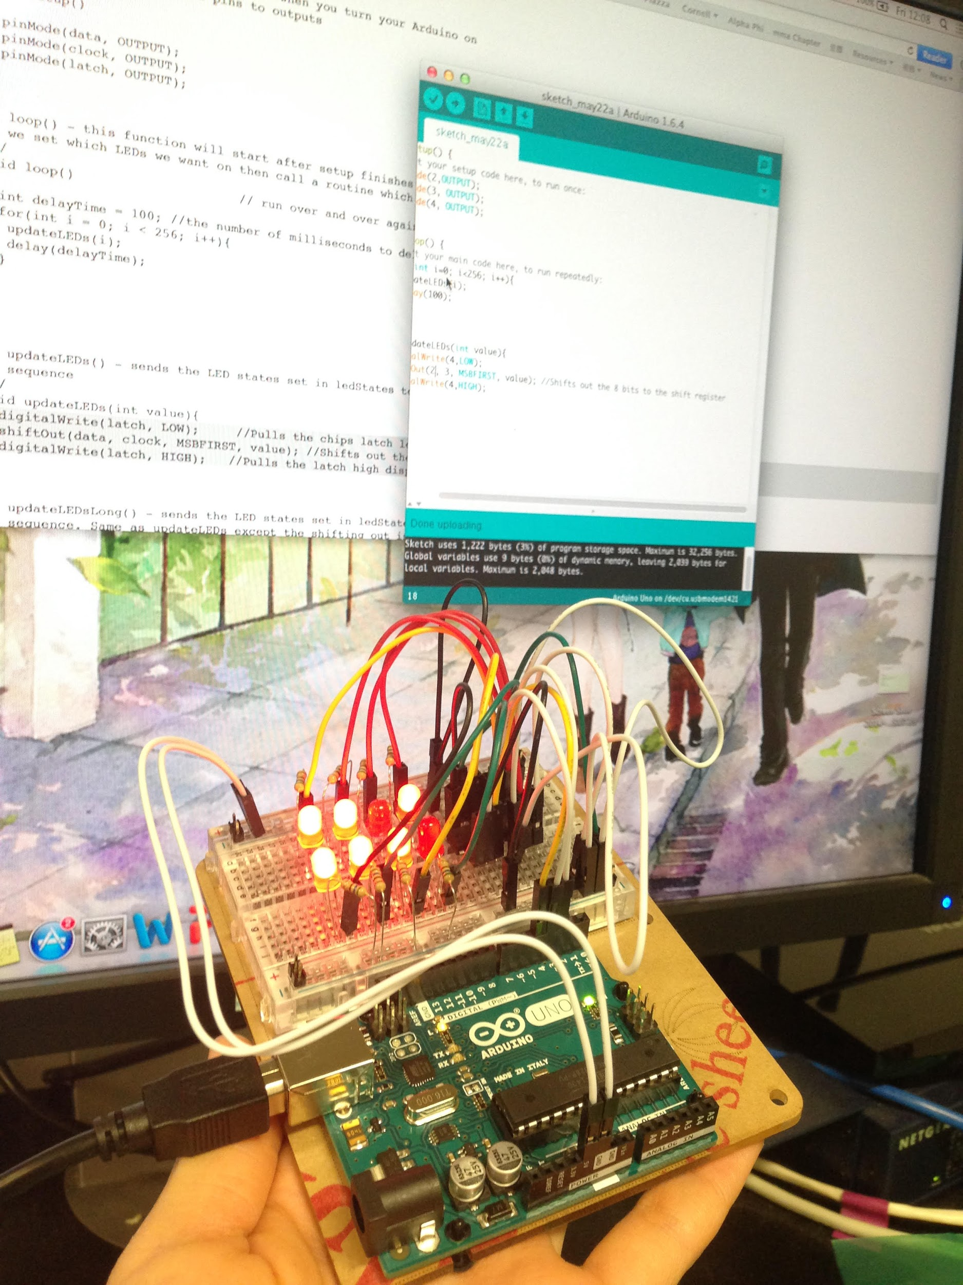
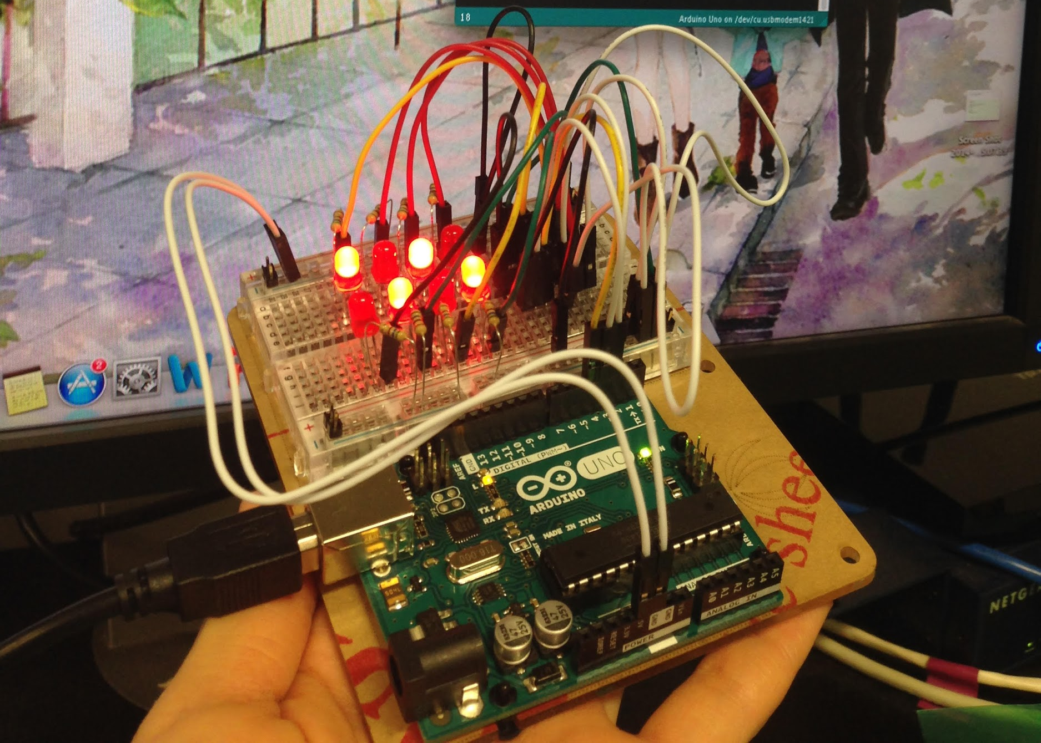
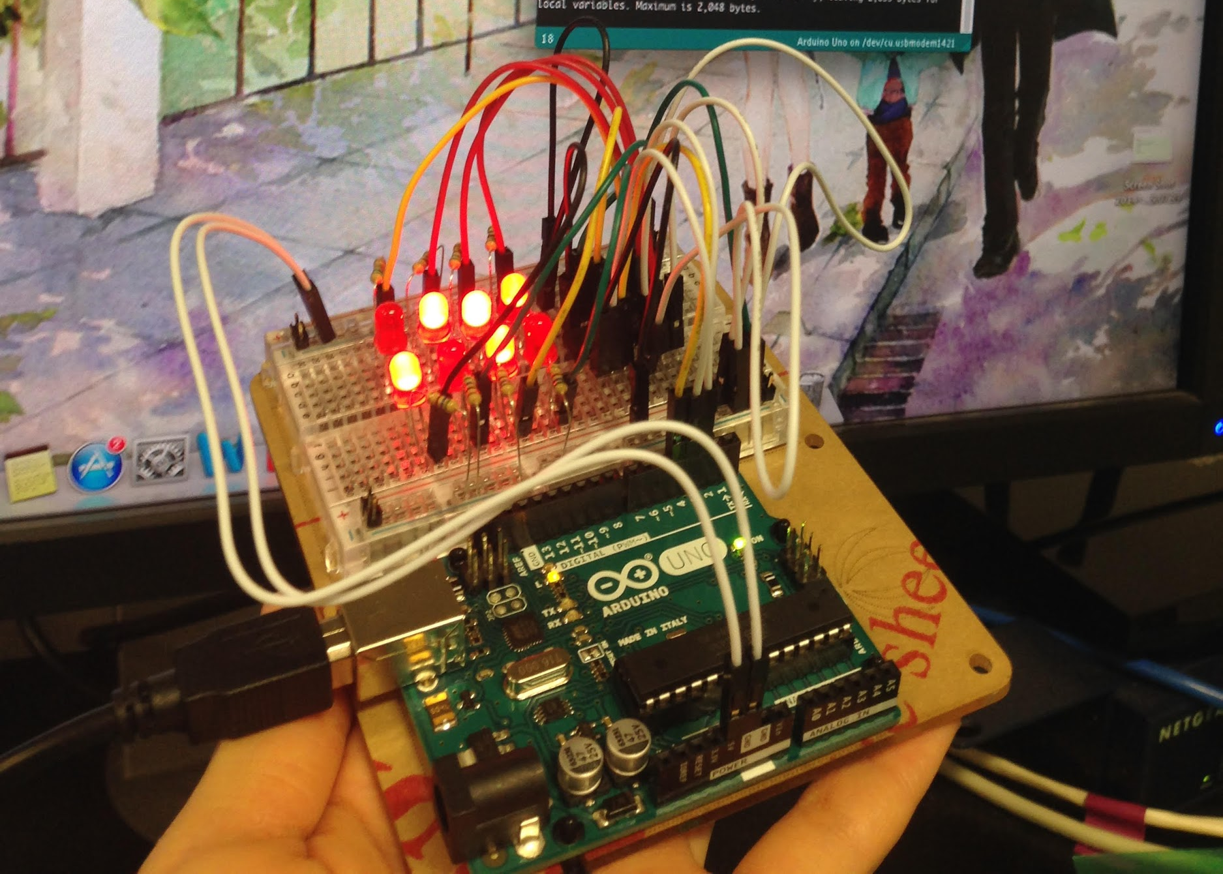

Binary Counter

Slide 9
Thoughts from Day 2
the MEng report is mainly focused on how to incorporate FPGA board to accelerate gesture recognition, which might not be necessary for every user
the instructions given in the appendix are frequently referring to Qiukai’s document
Installation instructions are based on older versions of softwares, especially for updating the driver software
Failed to install RealTerm
When uploading to github, might 1. organize the structure better and 2. make it clear what is necessary and what isn’t for users using keyboard/gesture or users with FPGA/without FPGA, etc.

Slide 10
May 23, Day 3
Changed the Arduino IDE to program from 1.5.3 (as in the original instruction) to 1.6.0 (or newer)
1.5.3 has some language issues about OS which makes it not compatible with a lot of computers
Set up WPA network on laptop (without TP Link) for all OS
http://www.howtogeek.com/194041/how-to-open-the-command-prompt-as-administrator-in-windows-8.1/

Slide 11
May 25, Day 4
Walk through the whole documentation
Keyboard control using Processing and Arduino IDE
Understand the code for Keyboard control

Slide 12
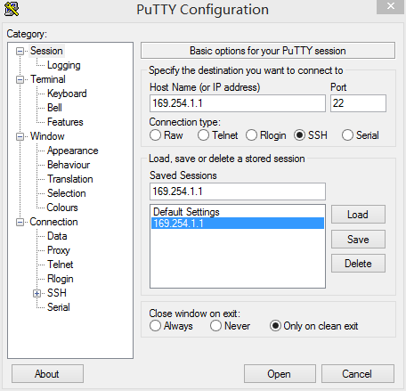
PuTTY
Configuration
[Update]
(must have Ethernet
cable plugged)

Slide 13
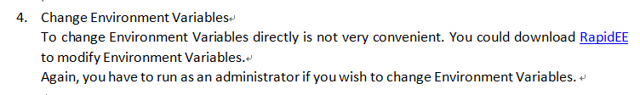
About Processing
Only keyboard control code is written in Processing
Easier for beginners without C background to use, very similar to Arduino IDE
To set environment variables, follow instructions in Reference 8 instead of RapidEE as in the original file

Slide 14
May 26
Understand the code for Visual Studio
Decode the Arduino IDE code
Weekly Meeting:
Blog: math and programming, jeremykun.com, computer vision/image processing/Fourier
Arduino code: 1 byte - WiFi/Serial port?

Slide 15
May 27
Revise the Arduino IDE code (fix useless variables, comments, hardwired parameters) and upload to Drive
Decode Visual Studio code in Google Slides
Read document “Make an Arduino- controlled Robot”
http://net2ftp.ru/node0/robot2010android@gmail.com/4.pdf

Slide 16
May 28
Get iRobot moving according to keyboard commands wirelessly
Decode Visual Studio code in Google Slides

Slide 17
May 29
more keyboard command tryouts:
can control iRobot without serial cable, but have to first plug in and then unplug, why? To activate loaded sketch?
without antenna: ~ -80dmB (vs ~-30dmB)
C++ syntax tutorial:
http://www.cplusplus.com/doc/tutorial/
Visual Studio: code understood. Running debug opened right windows then crashed.

Slide 18
Useful links to add:
http://blog.amastaneh.com/2014/03/opencv-on-visual-studio-2013.html
http://ionospherics.com/intel-galileo-setting-up-wifi/
includes WiFi setup instructions and Arduino error message interpretation

Slide 19
June 1
reproduced the Visual Studio/OpenCV gesture detection demo
in the “median” window, when the contour is blue, put box at max distance and wait for the contour to turn red. Then put at min distance and wait for the contour to turn pink. Then we are ready to start sending commands to the iRobot.

Slide 20
Important Note to Add (June 1)
in the Arduino code, the commands that writes to the iRobot (Op codes to start I/O and set in full mode) are in the setup() method, but not in loop(). When the Galileo board is powered on, it automatically starts to run the sketch uploaded to it most recently. If the iRobot is not powered on before the Galileo board, it will miss the setup() and we would not be able to write to it.
We should power on the iRobot first, then the Galileo board, wait for the power LED on iRobot to turn off, and send commands

Slide 21
June 2
More testing on Visual Studio demo
unable to go backwards?
division-by-zero exception?
read book “Make an Arduino- controlled Robot”
Arduino Leonardo. For Uno, need higher voltage p73.

Slide 22
June 3
Galileo manual
spark.io/start
Understand motor control in “Make an Arduino- controlled Robot”
see notes on next slide

Slide 23
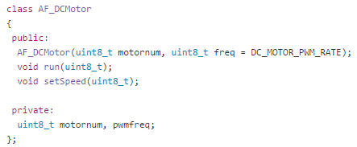

Infrared Reflection Sensor (IrSensor)
https://github.com/adafruit/Adafruit-Motor-Shield-library/blob/master/AFMotor.h
https://learn.adafruit.com/adafruit-motor-shield/af-dcmotor-class
PWM frequencies, parameters for directions...
constants
AFMotorController: device to start/stop/regulate speed/select rotation of the motor
Code in Arduino IDE
motor
import library AFMotor.h
(motor shield)
classes
AF_Stepper:motor that divides full rotation into steps; can hold at each step
AF_DCMotor
Initialize the motor for each wheel. 1st argument is a number of your choice, 2nd argument declares the channel that motor is connected to and the desired freq
constructor
in setup(), set the speed for each motor.
pwm range is 0-255, map to that range if necessary
in loop(), to move a motor in a certain dir, call class method run(cmd), where cmd specifies the directional parameter:
to keep running at that speed for a certain time, run(cmd) and delay(milisec)
to rotate in place, set left/right motors for/backward and vice versa
to rotate while running, set different speed for left/right motors.
need to design an algorithm to map rotation angle captured by camera w/ ratio of speeds of the motors on the two sides
See Chapter 7 of the book for calibration etc.

Slide 24
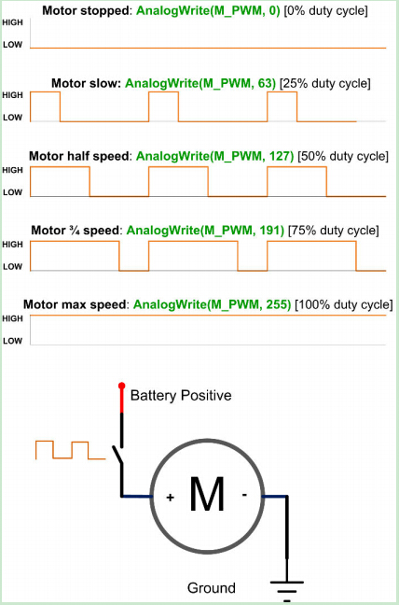
Notes on some terms:
PWM: Pulse Width Modulation
a technique for getting analog results with digital means
The duration of "on time" is called the pulse width. To get varying analog values, you change, or modulate, that pulse width.
used when writing to analog outputs. Max = 255, 100% time at max voltage.
PWM frequency defines the period that the analog output repeats the pattern, e.g. in the constructor for the motors. In setSpeed(), we set the actual pulse width.

Slide 25
June 4
Finished reading “Make an Arduino- controlled Robot” (finally!)
more on calibration, rotation, motor library…
skipped the last chapters on sensors
Math & Programming Blog
Primers on Fourier Series

Slide 26
Reading Notes:
RobotMotor.h header file & functions: Chapter 7 P121
Useful Link https://learn.sparkfun.com/tutorials/tags/arduino

Slide 27
June 8
OpenCV debugging; corner scenario that crashes the program as mentioned in report
tutorials on OpenCV libraries
hand detection
http://simena86.github.io/blog/2013/08/12/hand-tracking-and-recognition-with-opencv/

Slide 28
http://simena86.github.io/blog/2013/08/12/hand-tracking-and-recognition-with-opencv/
code: https://github.com/jujojujo2003/OpenCVHandGuesture/blob/master/main.cpp
report: https://sanjayslnarayanan.files.wordpress.com/2013/08/handtrackingopencv.pdf
hand tracking only: https://github.com/bengal/opencv-hand-detection
w/ explanation: https://ccrma.stanford.edu/~mborins/256a/theremax/posts/hand-tracking/
http://www.intorobotics.com/9-opencv-tutorials-hand-gesture-detection-recognition/
http://www.embedded-vision.com/introduction-computer-vision-using-opencv?gclid=CjwKEAjwndqrBRC16IyeqPicp3ASJAB-vB-ck0M4UNuhodFlcHC4sJkPaPmbXWrrY5bdnyiZHjVGcxoCCurw_wcB

Slide 29
June 9
fixed problem of not going backwards:
in the first three seconds after video processing is started, we set max and min ranges. The max and min areas detected here are used for calibration.
when frame is blue we set MinRange/MaxArea of the box, then MaxRange/MinArea of the box.
sometimes upon first running the program, skip this range setting (why? box in front of camera too early?). Need to remove box from camera and bring back to wake the range-setting function.

Slide 30
June 10
range setting:
hard-coded the first several seconds after detected area exceeds 100 to be the time for range setting. (what if box placed in front of camera in the first place? might start to count down these seconds before program has fully started ? )
revised code to let the program determine max and min area (mMax and mMin) based on detected values instead of predetermined sequence

Slide 31
June 11
Configure TP-link router
disable DHCP so that the router will not assign the Galileo board an IP address different from the one we specify when sending commands
as a result, must assign an IP address to the computer to connect to the router. For a device to connect to the router now, all except the last digit of its assigned IP have to be the same as the IP of the router
e.g. TP-link 192.168.0.1, computer 192.168.0.10
Weekly group meeting

Slide 32
June 15
Software code implementations:
press Enter to start, will not skip range setting
FPGA demo
Weekly group meeting w/ professor
update software code for filtering to match hw version. right now only square corner detection
start putting together the full tutorial w/ LaTex
present at blog meeting next week

Slide 33
Unsolved Problems
FPGA always mMin>mMax, stuck at step 3 “WAIT” in range setting until timeout
Software code not able to stop the robot when detected area very small (object removed from camera), although actually sending velocity=0 to the robot

Slide 34
June 16-18
finished assembling the robot, attached Arduino and motor shield
test sample sketches

Slide 35
We are using motor shield v2 instead of the older version in the book.
1. Need to install different libraries.
https://learn.adafruit.com/adafruit-motor-shield-v2-for-arduino , or for full tutorial https://learn.adafruit.com/downloads/pdf/adafruit-motor-shield-v2-for-arduino.pdf
2. Cannot use the sample codes provided in the book.
Summary of the new syntax on next page:

Slide 36
Connecting DC Motors
To connect a motor, simply solder two wires to the terminals and then connect them to either the M1, M2, M3, or M4. Then follow these steps in your sketch
Include the required libraries
Make sure you #include the required libraries
#include <Wire.h>
#include <Adafruit_MotorShield.h>
#include "utility/Adafruit_PWMServoDriver.h"
Create the Adafruit_MotorShield object
Adafruit_MotorShield AFMS = Adafruit_MotorShield();
Create the DC motor object
Request the DC motor from the Adafruit_MotorShield: Adafruit_DCMotor *myMotor = AFMS.getMotor(1); with getMotor(port#). Port# is which port it is connected to. If you're using M1 its 1, M2 use 2, M3 use 3 and M4 use 4
Connect to the Controller
In your setup() function, call 'begin()" on the Adafruit_MotorShield object: AFMS.begin();
Set default speed
Set the speed of the motor using setSpeed(speed) where the speed ranges from 0 (stopped) to 255 (full speed). You can set the speed whenever you want.
myMotor->setSpeed(100);
Run the motor
To run the motor, call run(direction) where direction is FORWARD, BACKWARD or RELEASE.
myMotor->run(FORWARD);

Slide 37
June 19
To solve the problem that Uno requires a separate WiFi shield, migrate to Galileo. Things to notice about the Adafruit Motor libraries:
if you get a compile error about missing certain avr files, and you are using a Uno board, make sure you have selected so from Tools->Board, since some boards such as Galileo and Due does not use avr, thus not having the related files in their directories.
if you get a compile error about “Wire1 not declared”/ “not in scope”, and you are using Galileo or Due, you need to modify the library files. Follow the error message to where “Wire1” appeared in the .ccp files and delete the “1”. Reference: https://communities.intel.com/message/242653

Slide 38
June 22-25
Work on documentation
http://research.microsoft.com/en-us/um/people/daan/madoko/doc/reference.html

Slide 39
Communication between computer and iRobot using serial cable, without Arduino board
incorporate Arduino board and computer-hosted WPA network
Smooth controlling of iRobot with keyboard commands using Processing
incorporate Visual Studio, OpenCV libraries and winsock
C++ project for video capture, image processing and command sending
incorporate TP-link router
C++ project for video capture, image processing and command sending through wireless router
develop FPGA implementation
heterogeneous robotic platform for real-time computer vision accelerated by FPGA

Slide 40
June 26
Develop Arduino program for new robot
Basic knowledge about motors: http://www.modmypi.com/blog/whats-the-difference-between-dc-servo-stepper-motors
https://www.doc.ic.ac.uk/~ajd/Robotics/RoboticsResources/ROBOTC%20-%20Improved%20Movement.pdf
Useful lecture slides: http://www.doc.ic.ac.uk/~ajd/Robotics/RoboticsResources/lecture2.pdf
Collection of resources: http://www.societyofrobots.com/programming_robot.shtml
http://www.lejos.org/nxt/nxj/tutorial/MotorTutorial/ControllingMotors.htm
http://www.robotshop.com/blog/en/how-to-make-a-robot-lesson-10-programming-your-robot-2-3627 (not so useful)

Slide 41
Robotics course from IC:
http://www.doc.ic.ac.uk/~ajd/Robotics/RoboticsResources/questions2.pdf

